Slide 1
Dynamic Programming
Chapter 10

Slide 2
Course Material
Data Structures
Tasks
Sorting
Searching
Analysis
Algorithms and Design

Slide 3
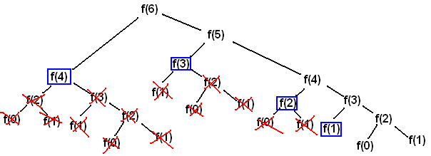
Templates - Dynamic Programming
https://commons.wikimedia.org/wiki/File:Algorithms-F6CallTreeMemoized.png
Notes:
Remember how divide-and-conquer broke things into pieces, often into recursive form?
-- well sometimes doing recursion is horribly inefficient. So memoize (i.e. store the answer if you are going to have to answer the same question later)

Slide 4
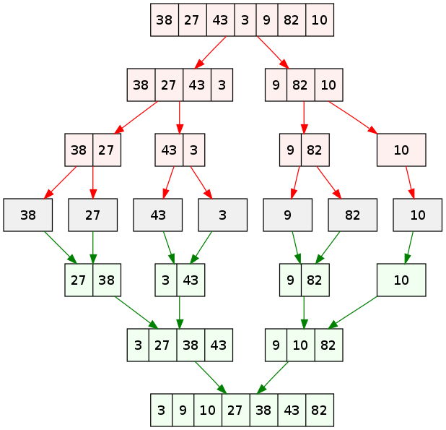
Dynamic Programming vs Divide-and-Conquer
Notes:
Divide-and-conquer speeds up a program by performing the expensive operations on only a few items (i.e. split the sort up until you are only sorting 3 items—that’s fast).
Dynamic programming speeds up a program by storing answers to common questions and not doing the work repeatedly

Slide 5
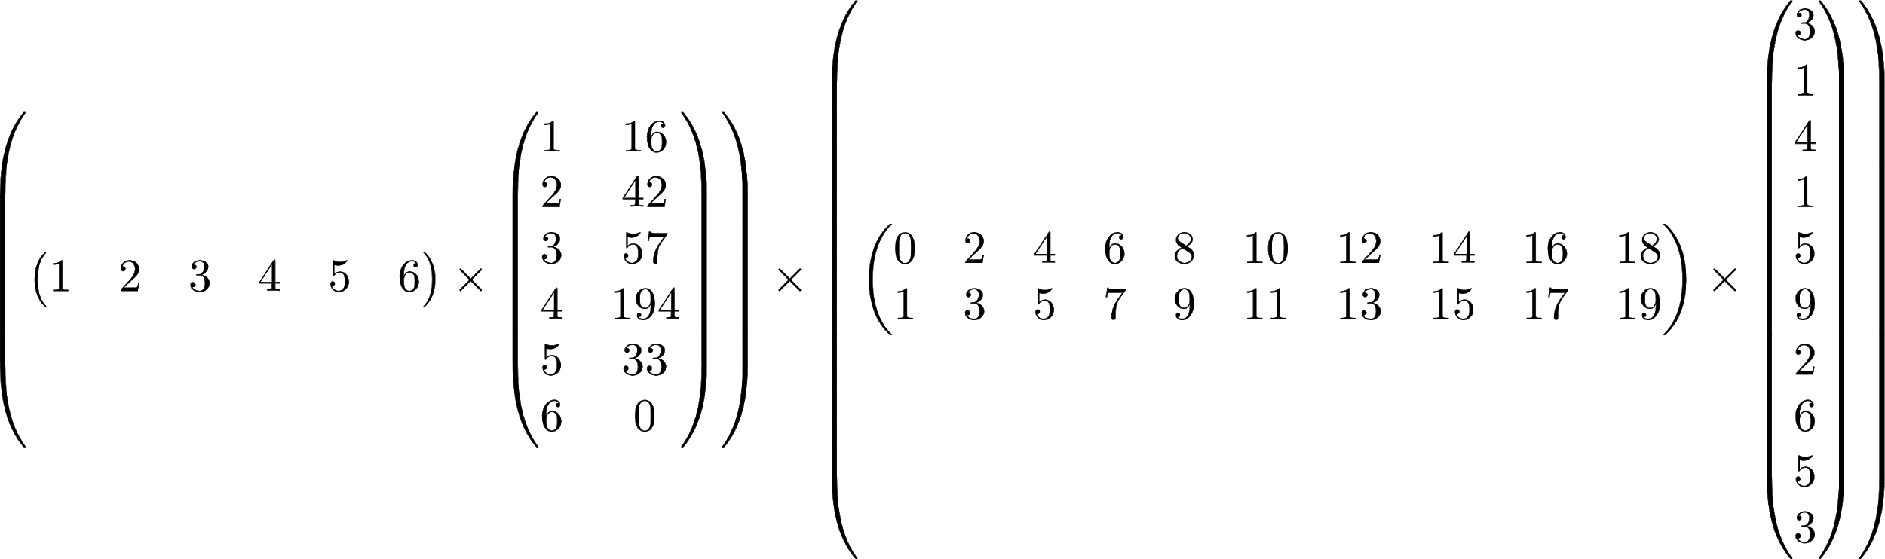
Matrix Chain Ordering
Notes:
What order you do matrix multiplication in can have a big impact on how many multiplications are required

Slide 6
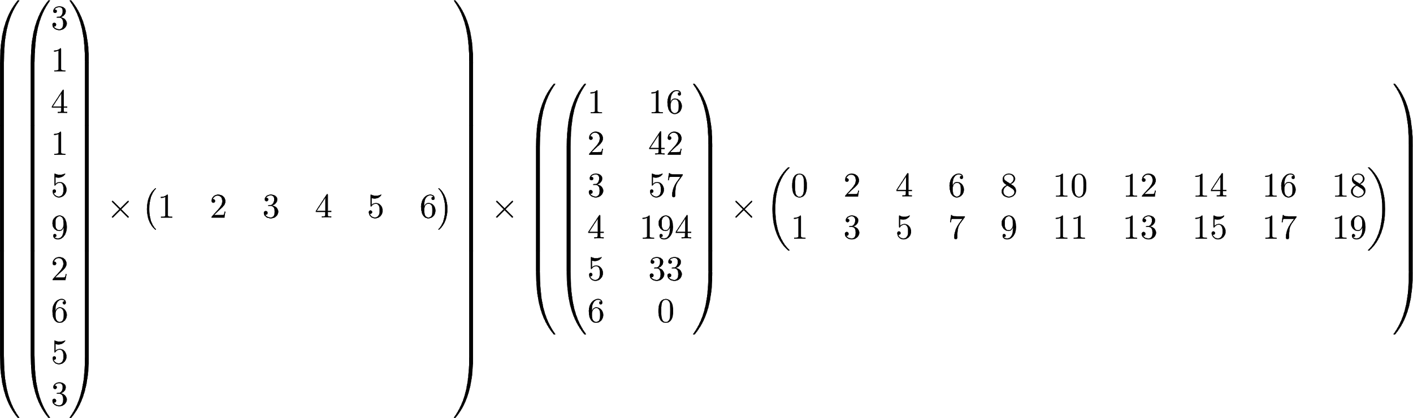
Matrix Chain Ordering
1*6*2 + 2*10*1 + 1*2*1
10*1*6 + 6*2*10 + 10*6*10

Slide 7
Matrix Chain Ordering
34 operations
780 operations
Notes:
Matrix multiplications are used in everything from simulating the US economy to making avatars turn in video games

Slide 8
Longest Common Subsequence
ABCBDABA length 8
BDCABA length 6

Slide 9
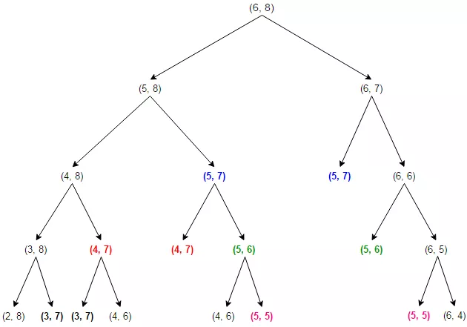
Longest Common Subsequence

Slide 10
Dynamic Programming
Problem requires calculation of exact same values multiple times
Store (memoize) those values and access them rather than re-calculating
Space-for-time
Map
Example

Slide 11
So Store Answers
...but how?

